Slide 1




ID Assignment 2
Leo Yun Tao, Lee Ming Feng
IT04

Slide 2
Development

Slide 3
Description
Our website features a combination of a game with the themes of an eCommerce site.
Unique Features
- A start page for the game
- A catalog page with products
- A product description page (Zoomed in view of product)
- A shopping cart page
- A end of game page
- Users can search for the products they want
- Users can select multiple tags to filter items
- Modal for profile and shopping list
- Timer for the game
- Restart button for the game
- End game button
Interactivity
-Hover animations and color changes
-Lottie and loading screen animations
-Slidein animations
-Interactive slideshow
-Interactive filters and searchbar
-Floating labels
-Pop-up modals
-Input boxes
-Subtotal corresponds to the quantity of product
-Alerts
APIs used
randomAPI
pixabay
restDB
Individual Contribution
W3C Code Validation

Slide 4

Screenshots

Slide 5

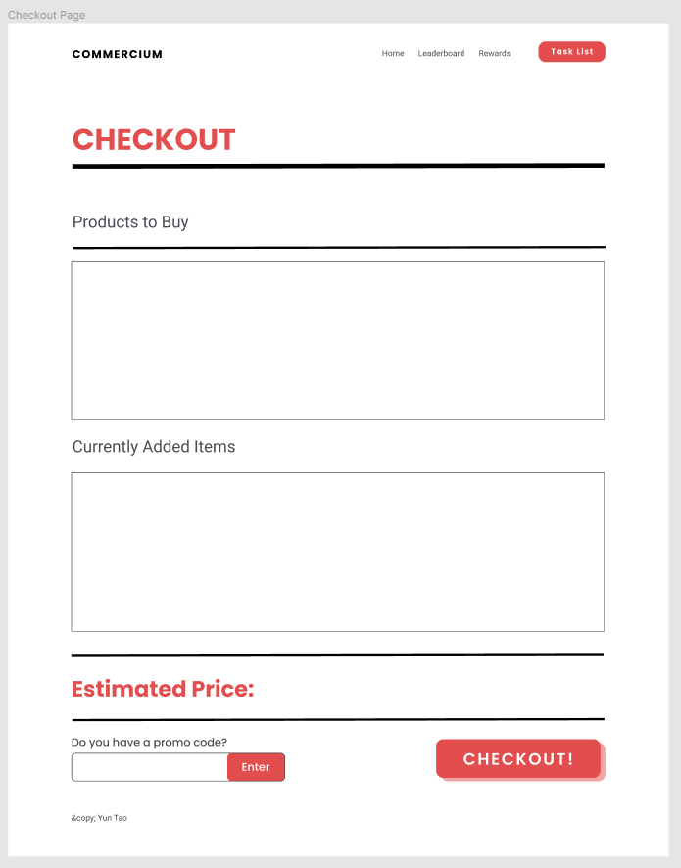
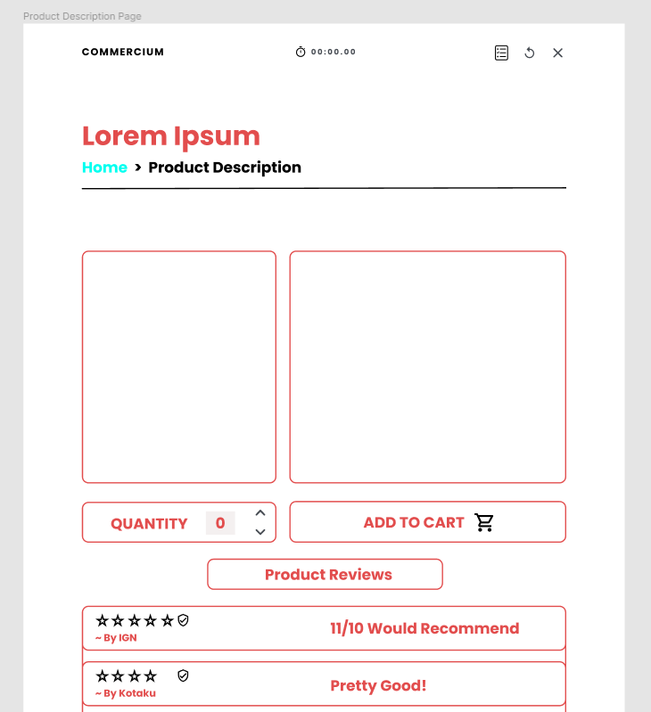
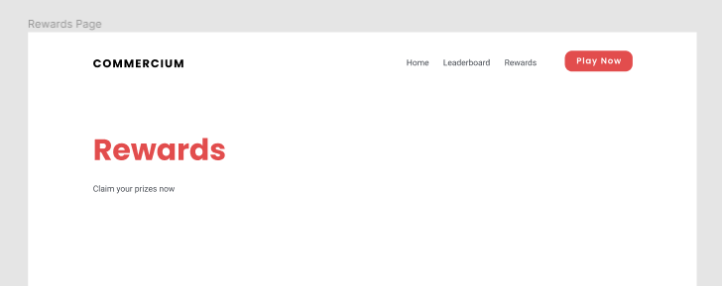
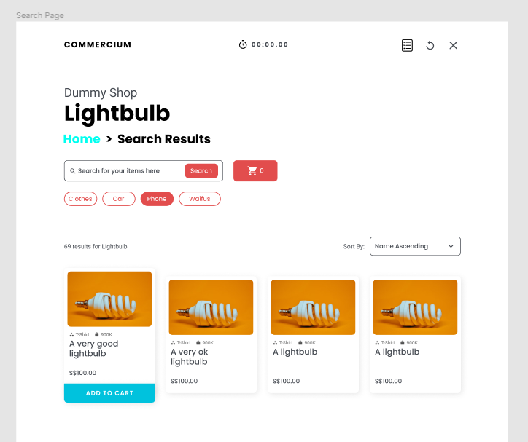
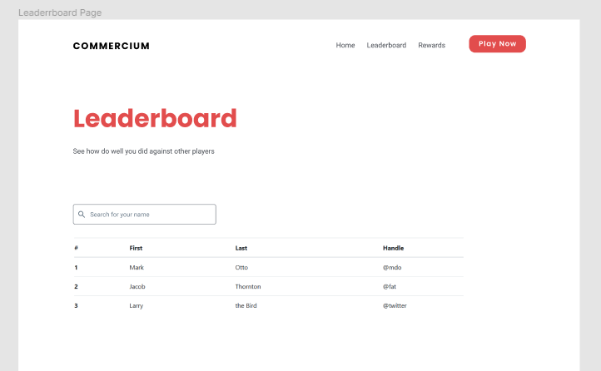
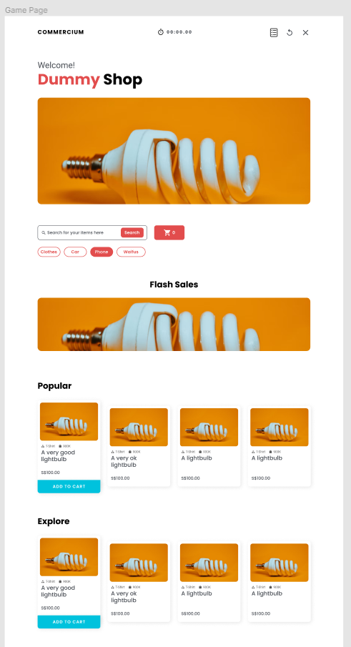
Wireframe Design

Slide 6
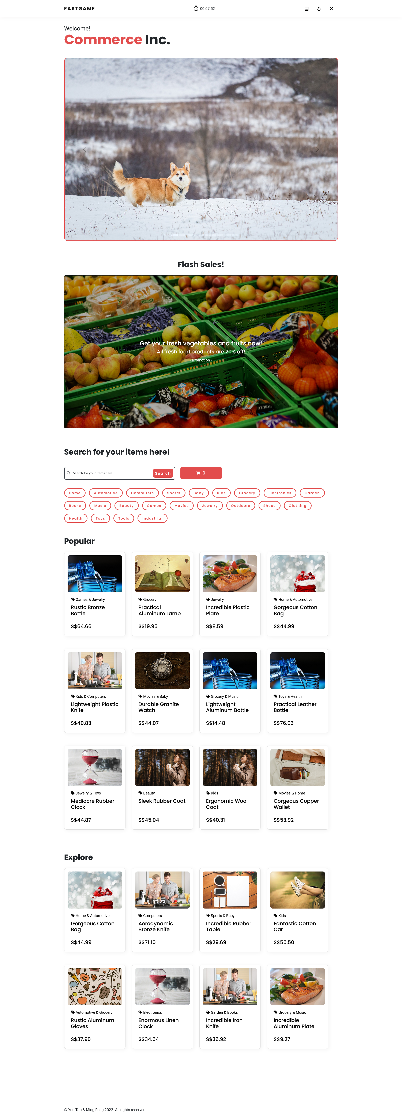

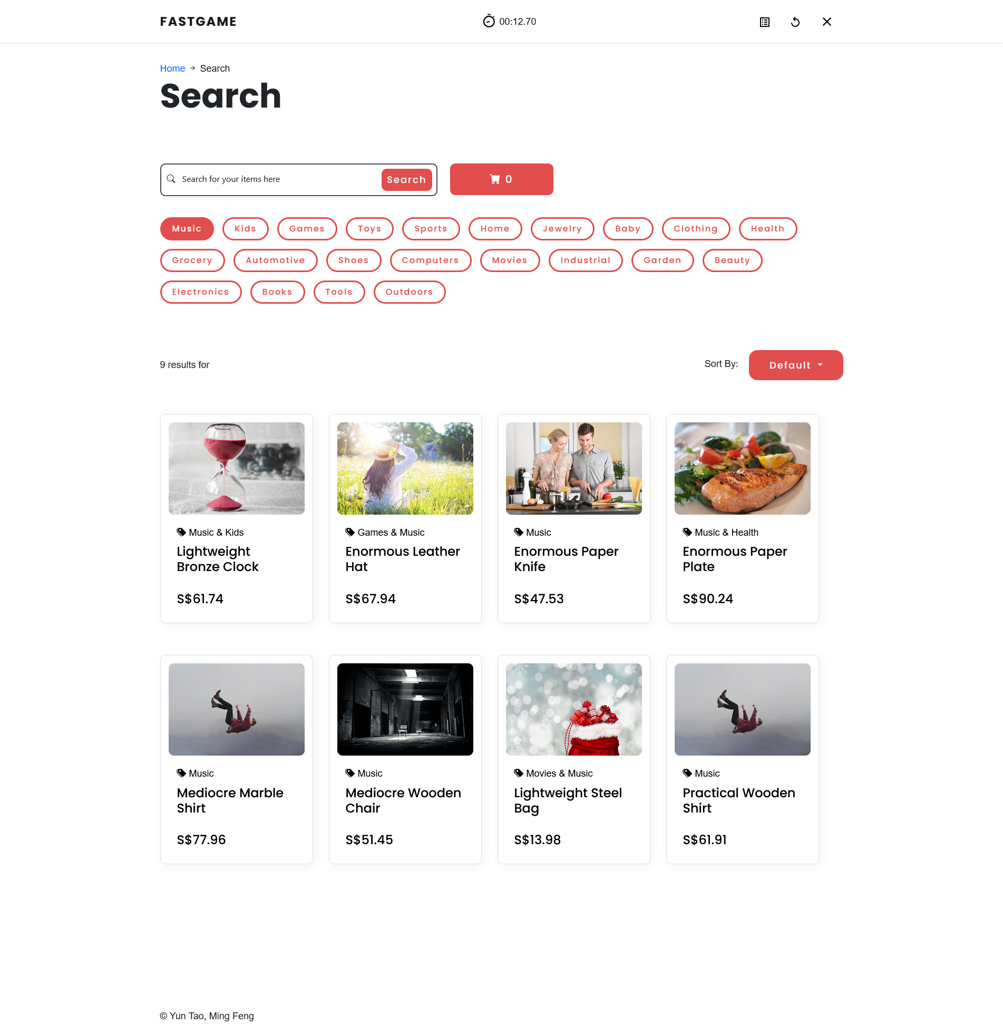
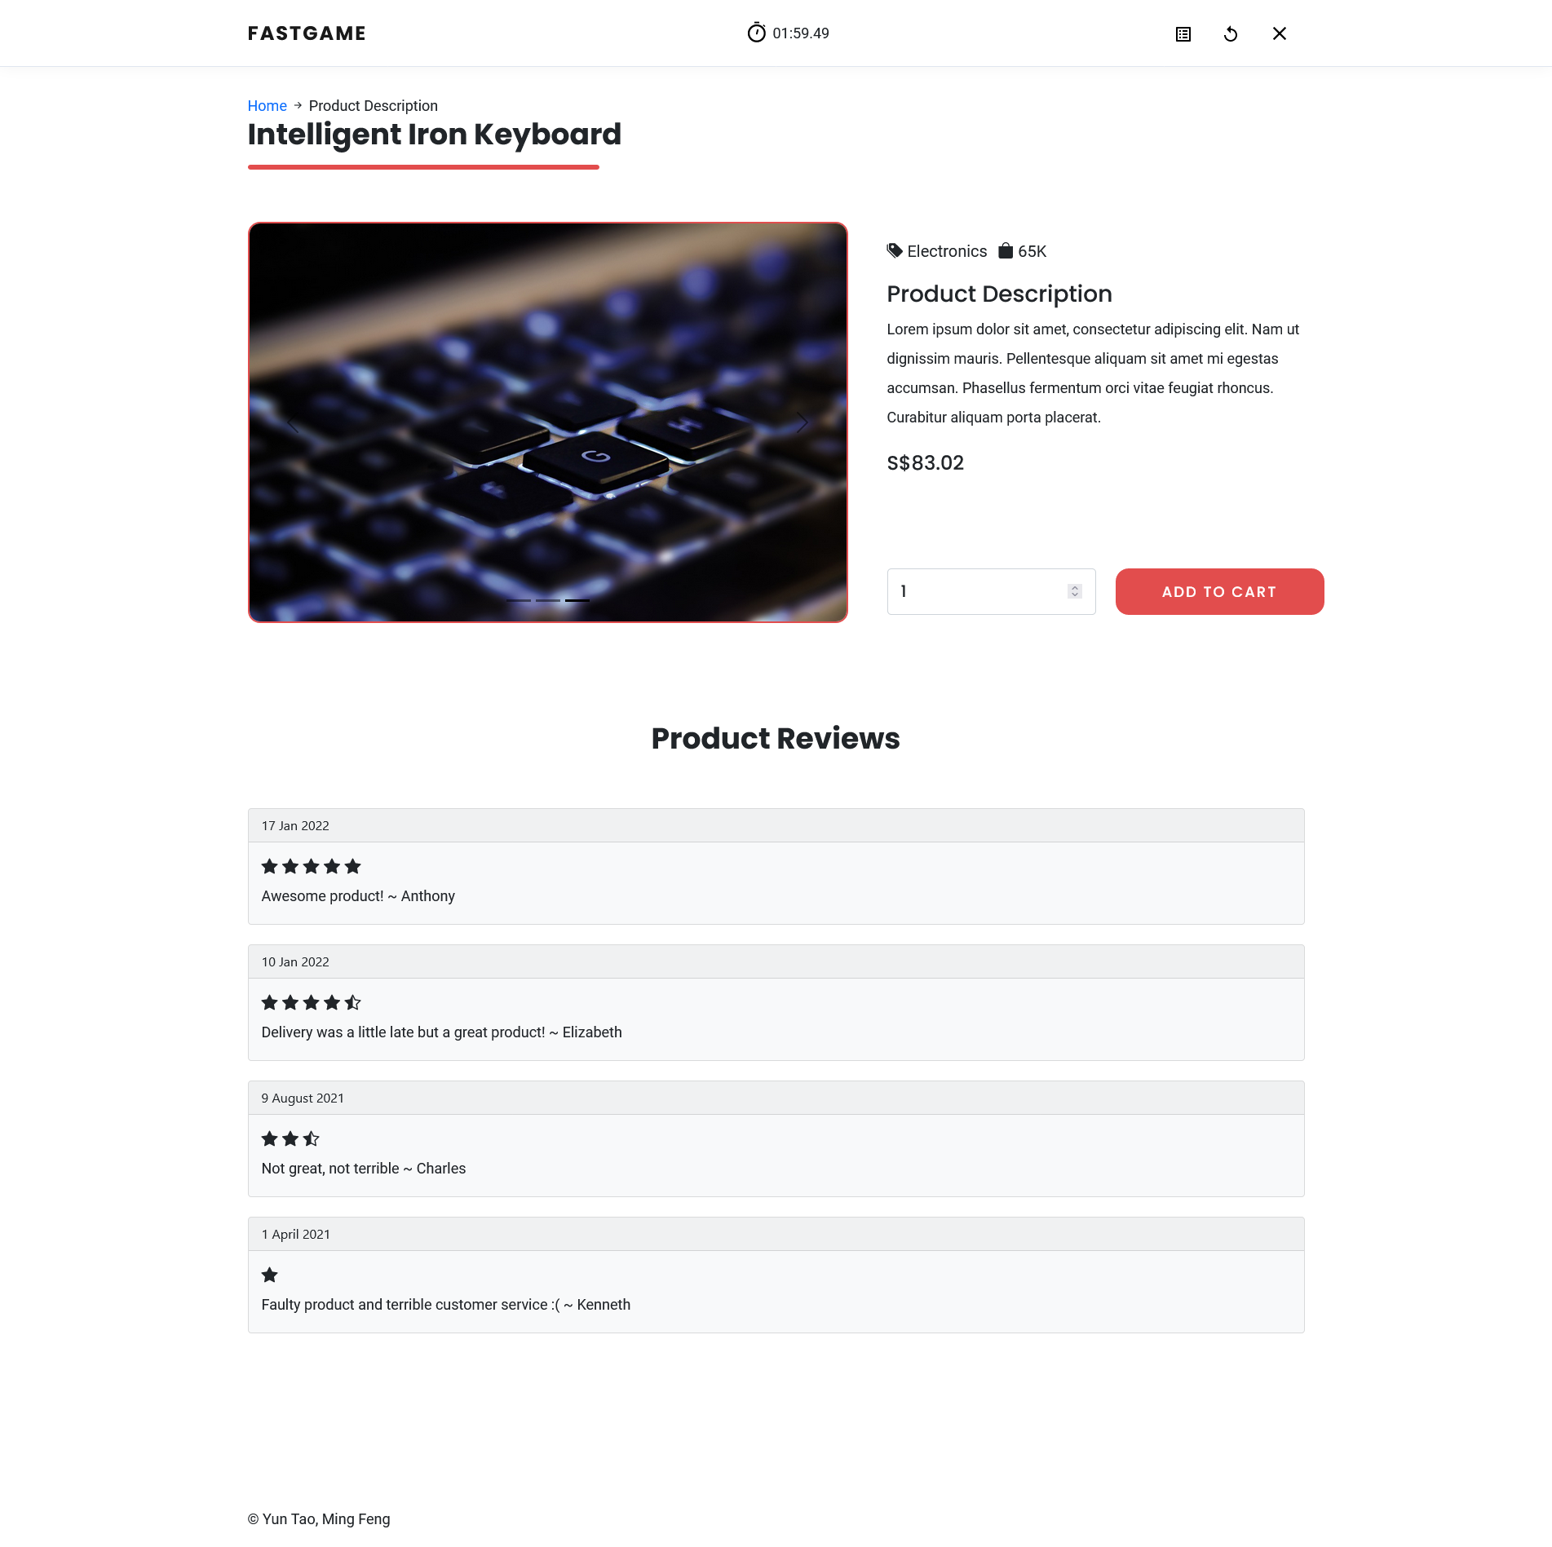

Slide 7
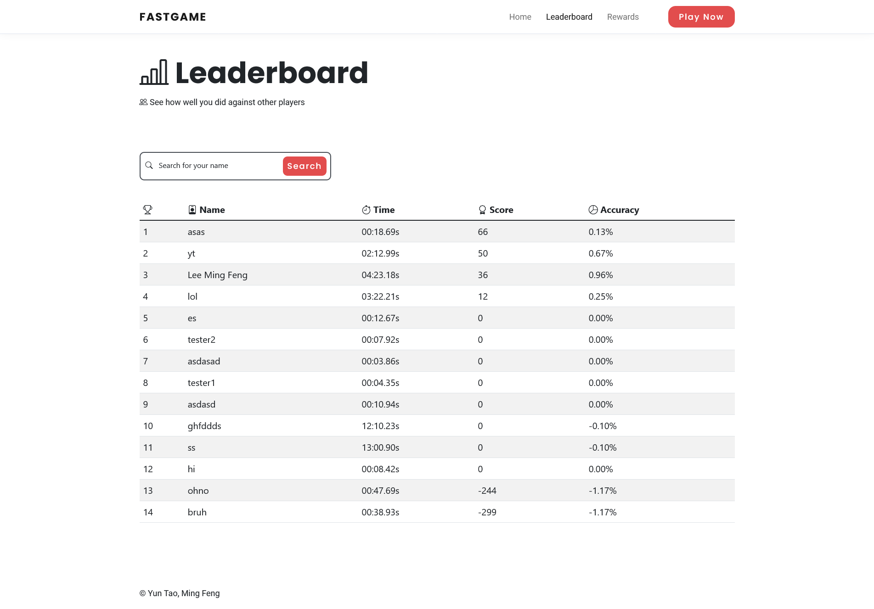
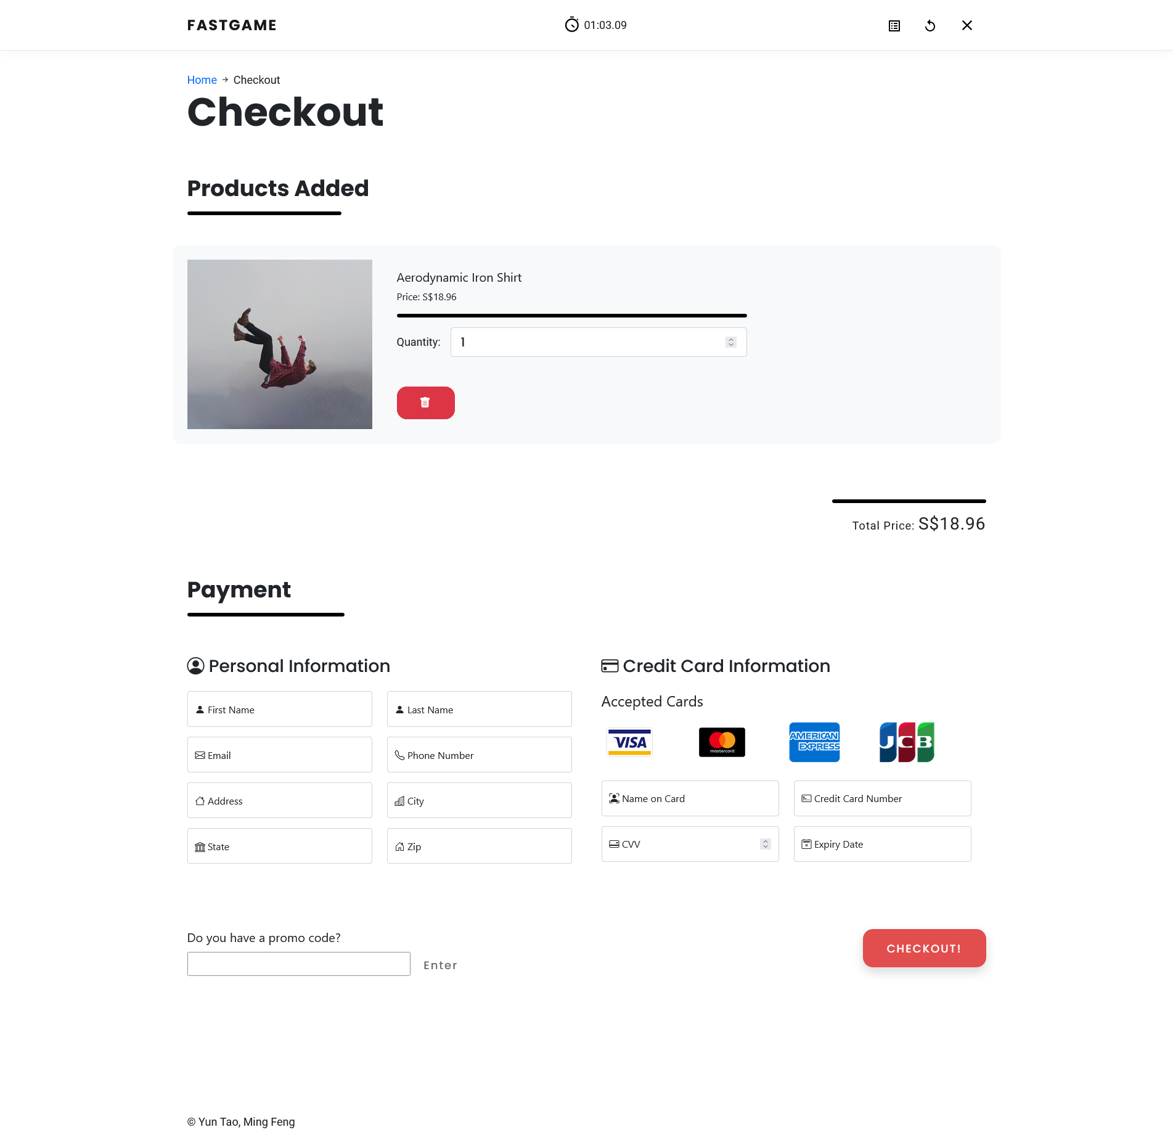
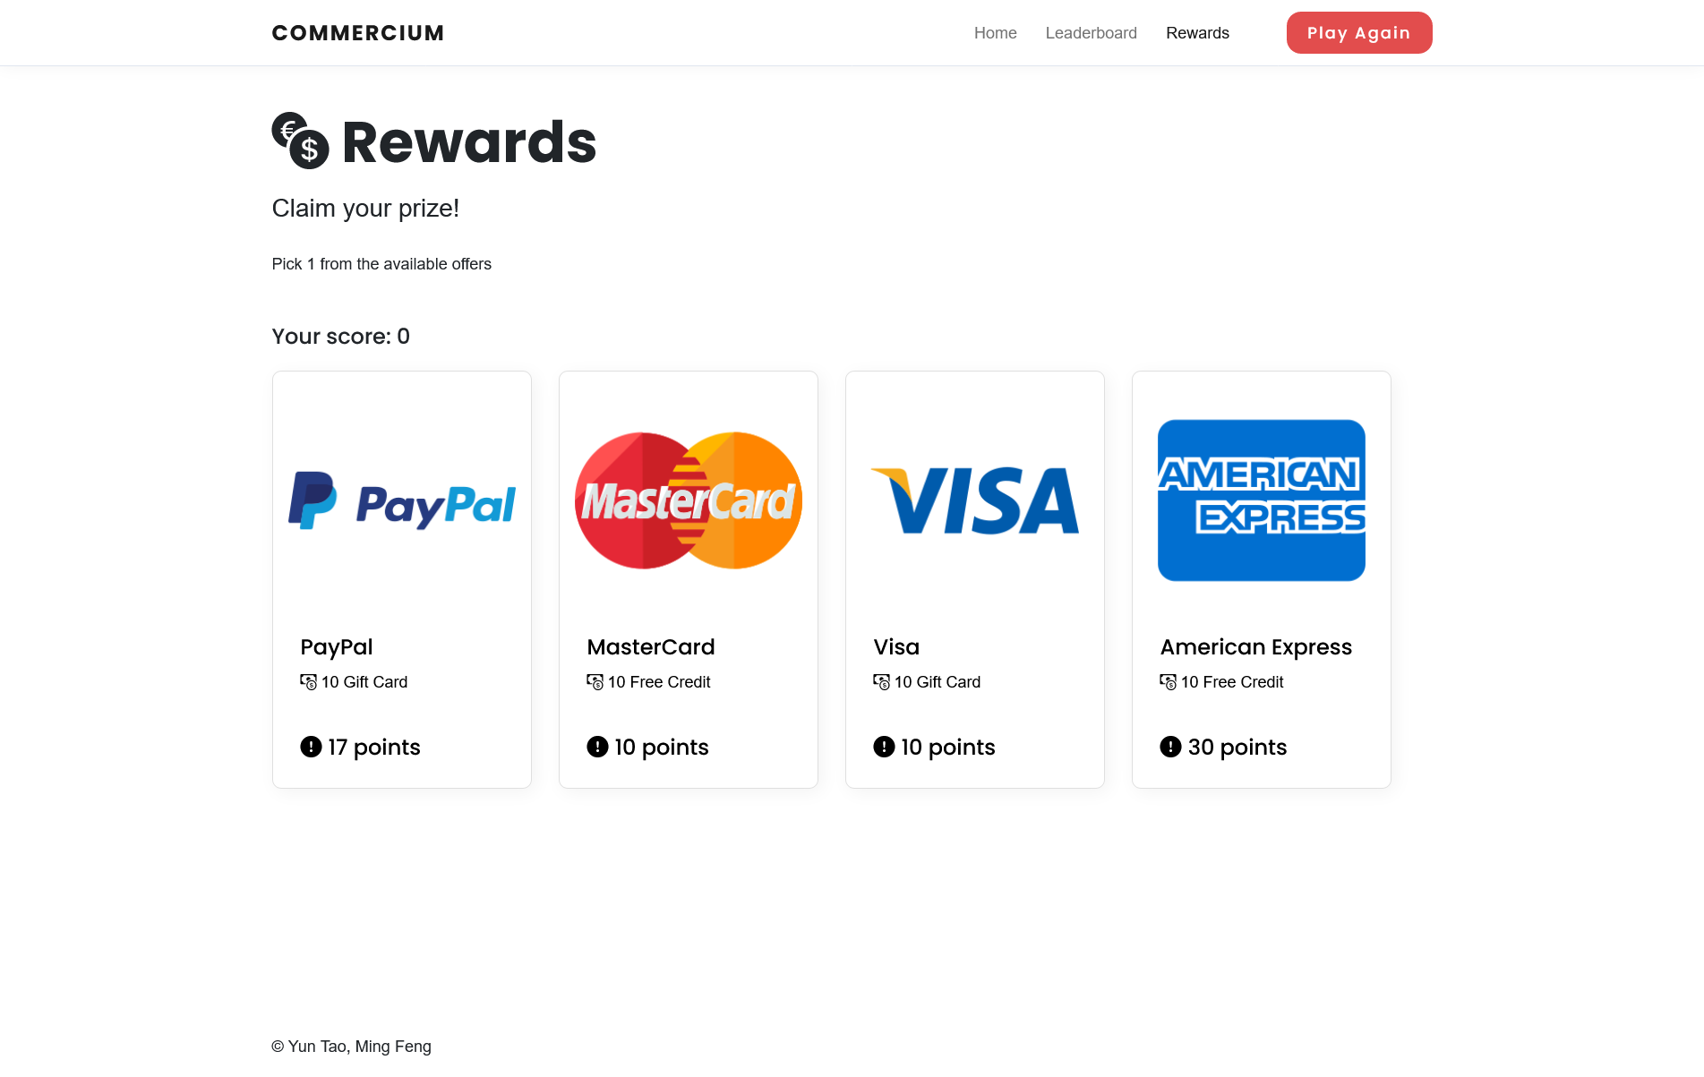

Slide 8
API

Slide 9
